Slide 1
Self-Serve Loan Onboarding
SaaS Platform
Product Requirements Document – Assessment Submission
Prepared By – Jeetri Sanjana
May 2026

Slide 2
Agenda
01
Objective & Goals
05
Key Features & Integrations
02
Problem Statement
06
MVP Scope & Success Metrics
03
Target Users & Solution
07
Risks & Future Enhancements
04
End-to-End Customer Journey

Slide 3
Objective & Problem Statement
OBJECTIVE
PROBLEM STATEMENT
Help banks & NBFCs digitize and simplify loan onboarding through a self-serve platform.
Customer Challenges
Long waiting times
Reduce onboarding turnaround time
Multiple branch visits
No real-time status tracking
Reduce manual verification effort
Repeated document submissions
Improve customer experience
Bank Challenges
Increase operational scalability
High manual workload
Slow verification process
Data entry errors
Operational inefficiency

Slide 4
Target Users & Proposed Solution
Loan Applicants
Bank Employees
Operations Team
Personal loan applicants
Verification reviewers
Loan account creation
Salaried employees
Approval / escalation
Disbursement processing
Standard KYC documents
Audit trail access
Repayment scheduling
Hybrid Model: Simple Loans → Self-Serve | Complex Loans → Assisted Onboarding
PROPOSED SOLUTION
A SaaS-based onboarding platform integrating with banking and third-party systems to automate: customer onboarding, eKYC verification, PAN validation, credit score checks, eSign workflows, and real-time application tracking — reducing manual intervention and accelerating loan processing.

Slide 5
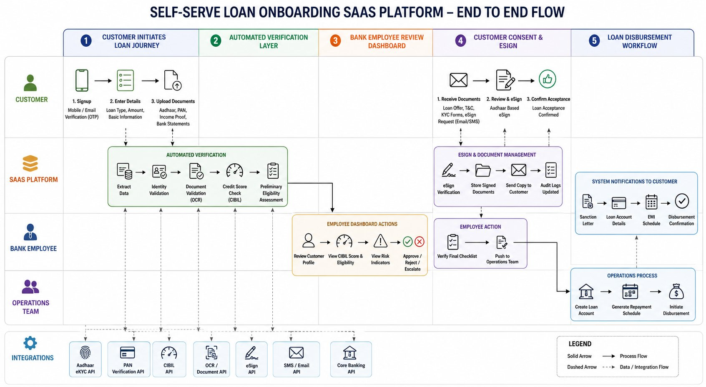
End-to-End Onboarding Flow
5-Phase Flow: Customer Initiation → Automated Verification → Employee Review → Customer eSign → Loan Disbursement

Slide 6
Customer Journey
1
2
3
Signup
Application
Auto Verification
Mobile OTP / Email verification
Select loan type, upload Aadhaar, PAN & income proof
Aadhaar, PAN, CIBIL score & OCR document checks
4
5
6
Employee Review
eSign
Disbursement
Bank employee reviews, approves, rejects or escalates
Customer receives sanction letter & completes Aadhaar eSign
Loan account created, repayment schedule generated

Slide 7
Key Features & Integrations
Customer Features
Employee Features
Operations Features
OTP login
Verification dashboard
Loan account creation
Document upload
Eligibility review
Disbursement processing
Real-time status tracker
Approval workflow
Repayment scheduling
eSign support
Audit logs
Notifications
API Integrations
Aadhaar eKYC
PAN API
CIBIL API
OCR Engine
eSign API
SMS/Email API
Core Banking
Identity verification
PAN validation
Credit score
Document extraction
Digital signature
Notifications
Loan account creation

Slide 8
MVP Scope & Success Metrics
✓ In Scope
✗ Out of Scope
Success Metrics
Customer signup/login
Corporate loan workflows
↓ 70%
↓ 60%
Document upload
AI fraud detection
Onboarding Time
Manual Effort
Aadhaar & PAN verification
Multi-country compliance
CIBIL integration
Advanced analytics
↓ 40%
↑ 50%
Employee dashboard
eSign workflow
Drop-offs
Completion Rate
Application tracking

Slide 9
Risks & Future Enhancements
Risks & Mitigation
Future Enhancements
Risk
Mitigation
AI-based eligibility recommendations
Fraudulent documents
Automated validation + manual escalation
Video KYC
API failures
Retry and fallback workflows
User confusion
Guided onboarding flow
Chatbot onboarding assistant
Compliance concerns
Audit logs and consent tracking
Fraud detection engine
Multi-language support

Slide 10
Conclusion
The Self-Serve Loan Onboarding SaaS Platform addresses the core challenges in today's manual, time-consuming loan processes. By automating verification, document handling, and approval workflows, the platform delivers:
Faster onboarding — minutes, not days
Reduced manual workload for banks
Better customer experience and transparency
Scalable, compliant, and integration-ready architecture
A scalable, digitally-driven onboarding solution for financial institutions.

